Slide 1
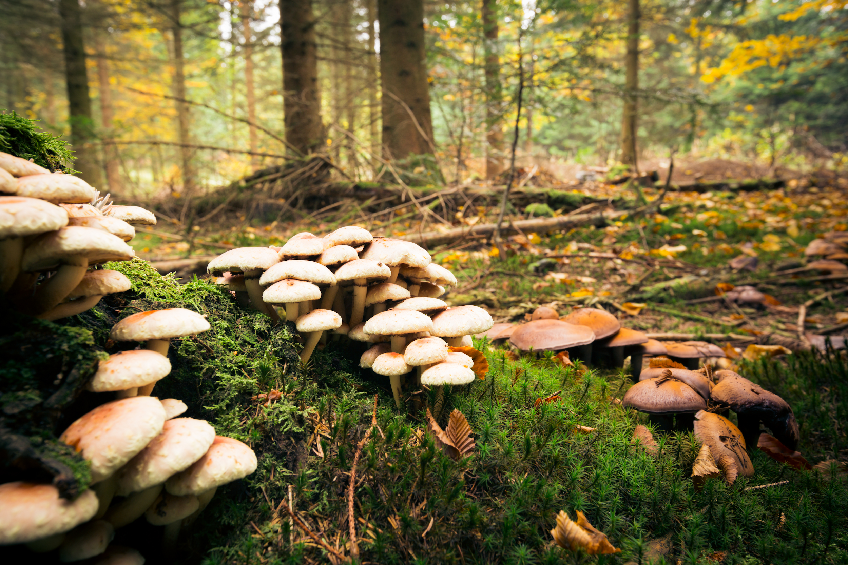
Mushroom Foraging: Feast or Fatal?
AI Boot Camp: Project 2 / Group 1
LADS Team Members:
1. LaShawn Sykes
2. Aaron Cranor
3. Darcy DeBord
4. Stephen Martinez

Slide 2
Executive Summary
Objectives:
Evaluate performance of multiple ML models (Random Forest, Logistic Regression, KNN, SVC) for classifying mushrooms as edible or poisonous
Findings:
Random Forest model outperformed other models in accuracy, precision, recall, and F1 score
Notes:
La Shawn:
The LADS team conducted a study to evaluate the performance of multiple machine-learning models in classifying mushrooms as edible or poisonous.
We explored the use of Random Forest, Logistic Regression, KNN, and SVC, and found that the Random Forest model outperformed the others in terms of accuracy, precision, recall, and F1 score.
Based on these findings, our study recommends the development of an application that leverages the Random Forest model as the primary classifier, with the potential integration of KNN and SVC for ensemble learning. This approach aims to provide foragers with a reliable tool to identify poisonous and edible mushrooms, thereby enhancing foraging safety and decision-making.
Please relax and listen to the rest of the LADS explain in detail what we accomplished.
Next Slide Please

Slide 3
Future Research
Investigate ensemble learning approaches
Expand dataset with more mushroom specimens
Incorporate user feedback and crowdsourcing
Create user-friendly mobile application
Notes:
La Shawn:
Boost Accuracy with AI: Suggest advanced AI techniques to make our system more accurate and reliable.
Expand Our Dataset: Add more types of mushrooms, including rare and hard-to-identify ones, to improve our model's performance.
User Feedback: Ways to use feedback from users and crowdsourcing to keep improving our mushroom identification tool.
Create a Mobile App: Develop an easy-to-use mobile app that uses our trained AI models to help foragers identify edible and poisonous mushrooms in the field.
Next Slide Please

Slide 4
Conclusion
Demonstrates potential of ensemble learning for complex problems
Inspires research in applied AI for natural resource management and conservation
Beyond mushroom foraging safety, it:
Promotes sustainable practices
Advances machine learning applications
Enhances appreciation for mushroom diversity
Shows broader impact of integrated AI systems on technology and environment understanding
Notes:
La Shawn:
"We've used advanced AI techniques to make our classification models better. By combining different machine learning algorithms, we can solve complex real-world problems more effectively. This innovative method can lead to more research and advancements in AI, especially in managing natural resources and protecting the environment.
Our study goes beyond just making mushroom foraging safer. It can:
Encourage sustainable practices
Push forward AI applications
Help people appreciate the importance of mushrooms in nature
By using integrated AI systems, our work has a wide-reaching impact. We believe it contributes significantly to technological progress and understanding the natural world."
Thank you everyone for listening. Any Questions or comments?

Slide 7
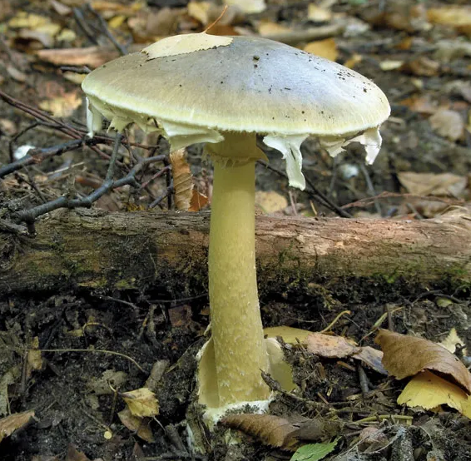
Death Cap (Amanita Phalloides)
POISONOUS
> One of the deadliest of all mushrooms.
> Closely resembles edible mushrooms such as straw and caesar’s.
> Within 6 to 12 hours after consumption, violent abdominal pain, vomiting, and bloody diarrhea appear. This leads to coma and death in more than 50% of recorded incidents.

Slide 8
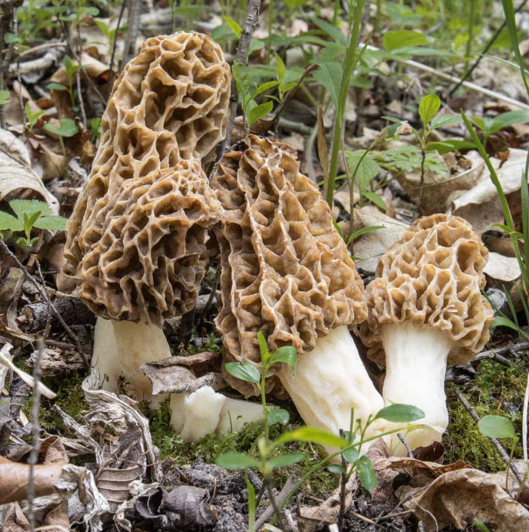
Common Riverbank morels (Morchella Americana)
EDIBLE
> Rich flavor and unmistakable meaty texture.
> One of the most famous mushrooms in the world.
> Rare, with a high retail price, morel season is short and hunting patches are often passed down in families like heirlooms

Slide 9
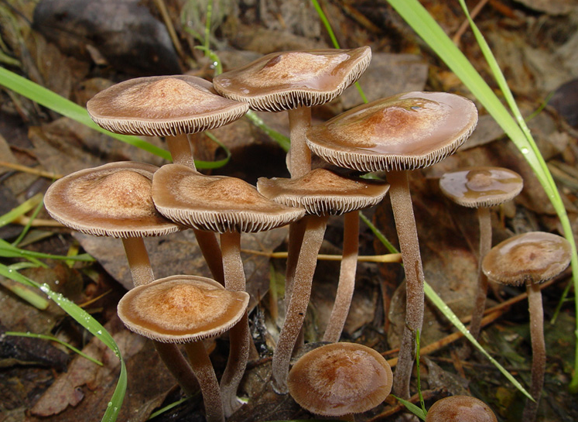
Banded Mottlegill (Panaeolus Cinctulus)
EDIBLE
> A type of psilocybin mushroom which contain hallucinogenic substances.
>

Slide 10
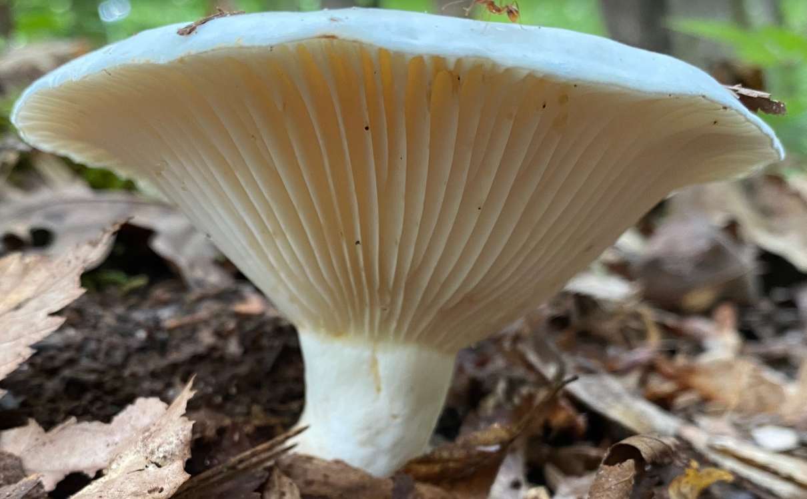

Slide 13


Slide 16
An executive summary or overview of the project and project goals. (5 points)
Objectives:
Evaluate performance of multiple ML models (Random Forest, Logistic Regression, KNN, SVC) for classifying mushrooms as edible or poisonous
Findings:
Random Forest model outperformed other models in accuracy, precision, recall, and F1 score
Notes:
La Shawn:
The LADS team conducted a study to evaluate the performance of multiple machine learning models in classifying mushrooms as edible or poisonous.
The researchers explored the use of Random Forest, Logistic Regression, KNN, and SVC, and found that the Random Forest model outperformed the others in terms of accuracy, precision, recall, and F1 score.
Based on these findings, the study recommends the development of an application that leverages the Random Forest model as the primary classifier, with the potential integration of Logistic Regression, KNN, and SVC for ensemble learning.
This approach aims to provide foragers with a reliable tool to identify poisonous and edible mushrooms, thereby enhancing foraging safety and decision-making.

Slide 17
DATA COLLECTION, CLEAN UP, & EXPLORATION
We sources two datasets from

Slide 18
The approach that your group took in achieving the project goals. (5 points)

Slide 19
Any additional questions that surfaced, what your group might research next if more time was available, or share a plan for future development. (3 points)

Slide 20
The results and conclusions of the application or analysis. (3 points)

Slide 21
What problem does the project attempt to solve?

Slide 22
How does the project solve this problem at a high-level ?

Slide 23
What steps were taken to develop the project

Slide 24
Demonstrate how the project solves the problem, as outlined in the narrative. Discuss any additional steps that might be taken to enhance the project in future iterations

Slide 26
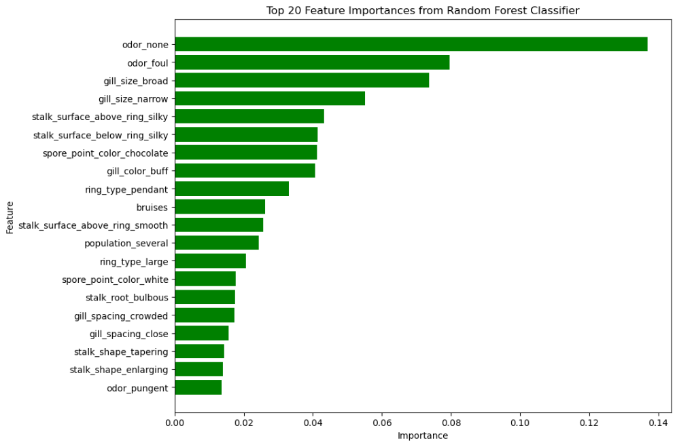

Slide 27
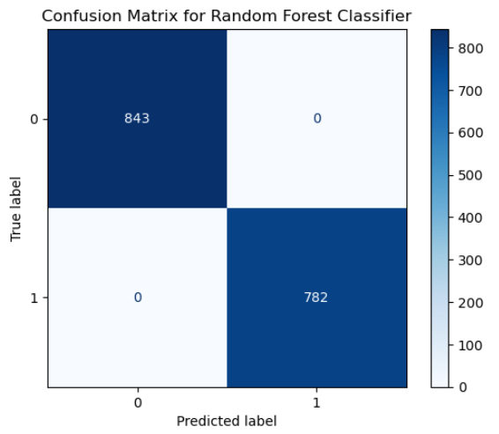
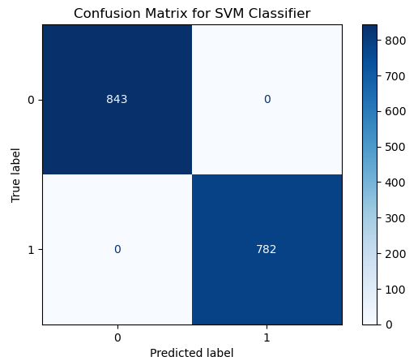

Slide 28
